Slide 1

Professional English
School of General Education Disciplines
Topic: Policy brief
Week 4. Practice 1-2
Term 1, 2026-2027

Slide 2
Objectives
By the end of this class, students will be able to:
identify the purpose and key features of a policy brief;
differentiate between appropriate and inappropriate writing styles for policy briefs;
discuss and evaluate the role of strategic foresight in AI policy;
apply knowledge by drafting a short group policy brief that identifies risks, skills, and strategies in their professional field.

Slide 3
Warm Up: Policy Brief or Scientific Article.
Read each statement and tag it PB (Policy Brief) or SA (Scientific Article).
Geared towards readers who have limited time to make a practical decision.
Aims to convince decision-makers to take action quickly.
More academic, focusing on scholarly roots of arguments.
Aims to present new knowledge to specialists.
Front-loaded: the conclusions are on the front page.
Written for a professional audience.
Rear-loaded: results and conclusions are at the end.
Written for an academic / scholarly audience.
Contains an executive summary (1–2 paragraphs).
Evaluated for intellectual and logical quality.
Contains an abstract (100–300 words).
Peer-reviewed for correctness and methodological robustness.
6

Slide 4
What is a Policy Brief?
1
2
3
How would you define a policy brief?
Who typically produces or contributes to policy briefs?
Who is the target audience for a policy brief?
PURPOSE
PRODUCERS
AUDIENCE

Slide 5
What is not a policy brief?
A policy brief is not simply a shorter version of academic research.
Not a research summary
It does not merely translate or simplify a scientific article. Research is selected and reframed around a policy issue.
1
Not research without a policy purpose
Evidence must be connected to a clear policy problem and its implications for decision-making.
2
It synthesizes relevant evidence rather than listing everything that has been written on the topic.
3
Not a compilation of studies
It avoids unnecessary jargon and dense academic language so that non-specialist decision-makers can read it quickly.
4
Not an academic paper
Key distinction:
A policy brief does more than report research — it turns evidence into a clear policy message and actionable recommendations.

Slide 6
Format: A Common Structure
There is no single fixed format, but effective policy briefs usually contain the following elements.
EXECUTIVE SUMMARY
Front-load the issue, key evidence and recommended direction.
1
2
3
4
INTRODUCTION
CONTEXT & PROBLEM
FINDINGS & OPTIONS
POLICY RECOMMENDATIONS
Set the purpose and orient the reader.
Explain the problem, why it matters and who is affected.
Present and interpret evidence; consider possible responses.
Propose specific, evidence-based actions.
The sections should work together as one argument: problem → evidence → implications → action.

Slide 7
Executive Summary
Give a busy reader the whole brief in miniature.
1
Problem
2
Key evidence
THE TEST
What is happening, and why does it matter now?
What are the most decision-relevant findings?
If the reader stops here, do they still understand the issue and what should happen next?
3
Implication
4
Action
What do the findings mean for policy or practice?
What should the target audience do?
Usually a short paragraph or a few focused bullet points.
Professional English | Week 4
9

Slide 8
Introduction
Orient the reader quickly — do not repeat the executive summary.
The introduction sets up the brief by defining its focus and giving the reader a reason to continue.
1
Focus
2
Relevance
3
Direction
Name the policy issue or question the brief addresses.
Explain why the issue matters to the intended audience now.
Signal what the brief will examine or argue.
Keep it brief: context belongs here only if it helps the reader understand the policy problem.
10

Slide 9
Context & Importance of the Problem
Establish that a specific policy problem exists and requires attention.
1
Define the problem
2
Explain why it exists
Show why it matters now
State the issue precisely. Avoid describing a broad topic when the brief needs a policy problem.
Summarise the most relevant causes, conditions, or affected groups. Include only context needed to understand the problem.
Establish scale, urgency, consequences, and policy relevance. Make clear what may happen if the issue is not addressed.
A strong problem section leads naturally to the evidence and, ultimately, to the recommendations.
11

Slide 10
Examination of Findings
Turn research evidence into information a decision-maker can use.
Do more than report data. Select, interpret, and connect the evidence to the policy problem.
1
Select
2
Explain
Interpret
4
Qualify
Prioritise the findings that are most relevant to the policy question.
Present data and research in clear, accessible language.
Explain what the evidence means rather than leaving the reader to infer it.
Acknowledge uncertainty, limitations, or competing explanations where relevant.
Evidence → Interpretation → Policy implication
12

Slide 11
Conclusions & Recommendations
Move from what the evidence shows to what should be done.
Recommendations should follow logically from the findings and identify realistic, evidence-based action.
1
Who?
2
Do what?
3
To achieve what?
Identify the actor responsible for taking action: government, institution, employer, professional body, or another stakeholder.
Use a specific action verb. Avoid vague recommendations such as “raise awareness” unless you explain how.
State the intended policy outcome and make the link back to the evidence.
Strong recommendation = Actor + Action + Intended outcome
13

Slide 12
Percentages are indicative rather than fixed rules.
Typical Structure of a Policy Brief
There is no single fixed format, but effective briefs usually contain these core elements.
TITLE
Engaging and informative — tells the reader what the brief is about
EXECUTIVE SUMMARY
about 10%
A concise overview of the problem, key findings and main recommendations.
INTRODUCTION 10–15%
FINDINGS / RESULTS & CONCLUSIONS about 30%
Establishes the issue, explains why it matters and creates curiosity about the brief.
Presents and interprets the most relevant evidence. Select only findings that help the reader understand the policy problem and its implications.
METHODOLOGY 5–10%
Briefly explains the evidence base or approach.
IMPLICATIONS / RECOMMENDATIONS about 30%
Translates the evidence into clear policy implications and specific actions.
REFERENCES / USEFUL RESOURCES about 10%
Keep sources selective, credible and easy to follow up.

Slide 13
Check Your Understanding: True or False?
Decide whether each statement is true or false. Justify your answer.
1
1. If the executive summary clearly presents the main findings, recommendations can be omitted because they appear later in the brief.
2
2. A policy brief may present strong evidence that a problem exists but still be ineffective if it does not establish why the issue requires policy attention.
3
3. Evidence that is methodologically important in a research article should also be explained in detail in a policy brief to demonstrate credibility.
4. A finding becomes policy-relevant when the writer explains what it means for the problem and for possible action.
5
5. f the evidence strongly supports a particular conclusion, persuasive language is more important than acknowledging limitations or uncertainty.
6
6. There is one fixed structure and percentage distribution that all policy briefs must follow.
9
Notes:
1. False
The executive summary should communicate the essential message of the entire brief, not merely summarize the findings. It should normally indicate the main policy direction or key recommendation(s). Busy decision-makers may read only this section.
2. True
Evidence alone does not automatically create a policy case. The writer needs to establish why the problem matters, who is affected, and why policy attention or action is required. Ask students: What is the difference between showing that a problem exists and showing that it is policy-relevant?
3. False
A policy brief needs enough methodological information to make the evidence credible and transparent, but it does not reproduce the methodological detail expected in a research article. The writer selects information according to the needs of a non-specialist, decision-oriented audience.
4. True
This is a central principle of policy writing. A finding becomes useful for policy when the writer interprets its significance: What does this evidence mean? Why does it matter? What are the implications for action? You can reinforce the sequence:
Finding → Interpretation → Policy implication → Action
5. False
Persuasiveness should not come at the expense of accuracy. Strong policy writing acknowledges relevant limitations, uncertainty and qualifications while still making a clear evidence-based case. This is a useful point to revisit later when students analyse hedging in the OECD brief.
6. False
There is no single mandatory structure or percentage distribution for all policy briefs. The proportions presented earlier are useful planning guidelines. Actual structure and emphasis depend on the purpose, audience, issue, evidence and institutional conventions.

Slide 14
Writing Style: Dos and Don’ts
In pairs, decide which choices make a policy brief clear, credible, and useful to decision-makers.
DO
DON’T
Be concise and focused
Rely on unexplained jargon
Prioritize the information the reader needs to understand the issue and act.
Specialist terminology can make the brief inaccessible to decision-makers.
Write for a professional, non-specialist audience
Use dramatic or exaggerated claims
Explain technical ideas clearly and remove unnecessary academic detail.
Persuasion should come from credible evidence, not sensational language.
Prefer active, direct sentences
Repeat the same point unnecessarily
Make the actor and the action easy to identify.
Front-load key messages, then use later sections to develop and support them.
Use strong verbs
Use complexity to sound authoritative
Prefer “the study examines…” to “an examination of…” when the verb is clearer.
Dense academic sentences can hide the policy message rather than strengthen it.

Slide 15
Spot the Style Problems
Work in pairs. Identify all the policy-brief style problems in each sentence. Some contain more than one violation.
A
Unnecessary wordiness
B
Academic / specialist jargon
C
Overly complex structure
D
Weak or nominalized verbs
E
Passive / indirect wording
F
Dramatic or exaggerated claim
G
Unnecessary repetition
H
Unsupported certainty
1
The implementation of comprehensive workforce-development initiatives is of considerable importance for the facilitation of employee adaptation to AI-driven transformations.
2
AI will undoubtedly transform every profession, and governments must act immediately before it is too late.
3
A consideration of the development and subsequent implementation of appropriate training programmes should be undertaken by relevant policymakers.
4
Recent evidence highlights the growing importance of AI skills. AI skills are becoming increasingly important for workers. Therefore, developing AI skills should be an important policy priority.
5
The operationalization of cross-sectoral reskilling mechanisms may facilitate the amelioration of labour-market mismatches resulting from technological disruption.

Slide 16
From Academic to Policy-Friendly Language
Policy briefs should be accessible to non-specialist readers. Replace each word or phrase with a clearer alternative.
ACADEMIC / FORMAL
CLEARER ALTERNATIVE
operationalize
facilitate
endeavour
ascertain
ameliorate
adverse
commence
in the vicinity of
expeditiously
aggregate
corroborate
Discuss: Are formal or academic words always inappropriate in a policy brief? Why / why not?

Slide 17
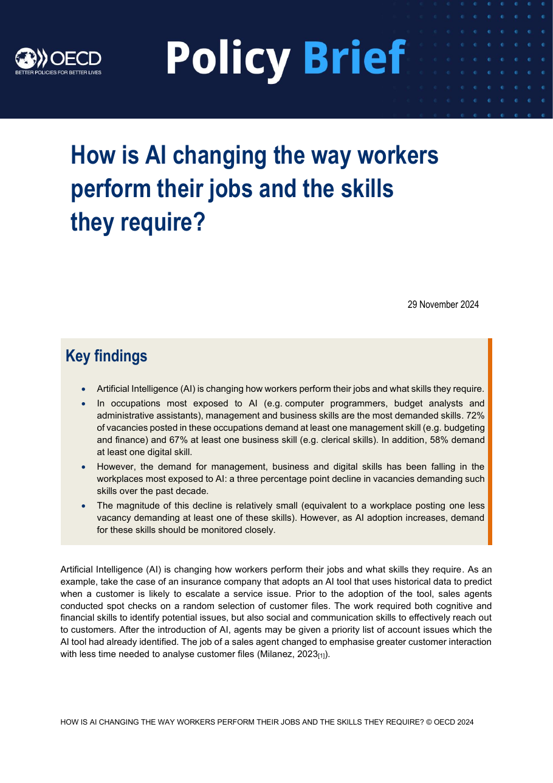
Analyse a Policy Brief
Skim page 1 for 60 seconds.
1
Who produced the brief, and who is its likely target audience?
2
What policy issue does the title immediately establish?
3
Where has the writer placed the most important information?
4
If you had only 30 seconds, what would you read first?
5
What features make the first page easy to scan?

Slide 18
Deconstruct the Key Findings
Read the four Key findings on page 1. Match each finding to its main rhetorical function.
A
Provides headline quantitative evidence
B
Introduces a contrasting finding
Discuss:
Why did the authors select these four points for the first page rather than simply summarising everything in the brief?
C
Qualifies the evidence and signals a policy need
D
Establishes the overall issue

Slide 19
Read the insurance-company example on page 1 and reconstruct the change in work.
BEFORE AI
AI INTERVENTION
CHANGE IN TASKS
CHANGE IN SKILLS
What did sales agents do?
→
What does the AI tool do?
→
What work is reduced or changed?
→
Which human skills become more important?
Why might the authors use this example before presenting their methodology and detailed data?

Slide 20
Map the Whole Brief
Skim all six pages. Locate each function — do not assume the headings will match the textbook labels.
1
Key messages / executive summary
5
Visual evidence
2
Context and problem
6
Policy implications
3
Methodology
7
Recommendations / proposed responses
4
Findings and evidence
Does the OECD brief follow exactly the structure we studied earlier? What is different?

Slide 21
Midterm Assignment: Policy Brief
Work in groups to develop an evidence-based policy brief on the impact of AI in your professional field.
YOUR TASK
EMPLOYMENT RISKS
Create a short policy brief in PDF format that explains how AI is affecting your professional field and proposes evidence-based responses.
1
Identify 2–3 significant ways AI may affect employment, tasks, or job quality in your field.
FUTURE WORKFORCE SKILLS
2
Identify the cognitive, technical, and interpersonal skills workers will need as AI use expands.
Use relevant visuals where they help communicate evidence or key messages.
POLICY RESPONSE
3
Propose concrete actions that employers, educators, professional bodies, or policymakers could take.
PROFESSIONALISATION
Be ready to defend your policy choices and recommendations.
4
Suggest how training, job design, standards, status, or working conditions could be strengthened in AI-affected roles.
Submission
PDF • Group work
Evidence
Support claims and recommendations with credible research and reports.

Slide 22
Structure of the Policy Brief
1. Executive Summary. Concise overview of the problem, its significance, main findings and key recommendation(s) | 10
2. Context and Problem Statement. Clearly explains how AI is affecting the selected professional field, identifies the key stakeholders affected, and analyses 2–3 significant employment/workforce challenges. Establishes, using evidence, why the issue requires policy attention. | 15
3. Evidence and Findings. Uses relevant evidence from at least five credible academic and/or institutional sources, including evidence directly relevant to the selected professional field. Evidence is selected, synthesized and interpreted to analyse AI-related changes in employment, work tasks and/or skill requirements in the selected professional field. Identifies and analyses the cognitive, technical, and interpersonal skills workers will need as AI use expands, explaining how these skills relate to the identified changes in work. Key claims are supported with evidence and their policy relevance is clearly established. | 20
4. Policy Recommendations. Proposes 1–2 specific and feasible recommendations that clearly follow from the findings. Identifies the responsible stakeholder(s) and the intended outcome(s) of each recommendation. | 15
5 References. Sources are appropriately acknowledged through in-text citations, and the reference list is consistently formatted according to APA 7. | 5
6. Policy-Brief Style and Language. Writing is clear, concise and professional and is appropriate for a non-specialist decision-making audience. Grammar and vocabulary are accurate and appropriate. Unnecessary jargon, repetition and overstatement are avoided. | 10
Presentation
Delivery and audience engagement — clear voice, appropriate pace, eye contact, limited reliance on notes (6) Organisation and signposting — logical presentation, effective transitions and signposting (5) Spoken language — appropriate professional vocabulary, grammatical accuracy and pronunciation (6) Understanding and defence — demonstrates understanding of the evidence and recommendations and responds effectively to questions (6) Time management – 8-10 minutes (2) | 25
Total | 100

Slide 23
Additional task 1: Extension: Read Like a Policy Analyst
Real policy briefs use specific rhetorical moves to persuade a busy, non-specialist reader. Skim two short excerpts from real institutional briefs on Moodle and discuss:
1
What hedging or certainty language does the writer use when presenting risk (e.g. “likely to”, “is expected to”)?
2
Where does the writer front-load the recommendation, and where do they justify it?
3
Which sentence would you keep if you had to cut the brief in half? Why?
4
How does the tone differ from an academic abstract on the same topic?
18
Notes:
The acronym OECD stands for the Organisation for Economic Co-operation and Development.

Slide 24
Additional task 2: Discussion of a UN Policy Brief
1. Based on what you have read, formulate 3–5 key messages of this policy brief.
2. Write down these key messages.
3. After reading, discuss the following questions.
Discuss:
Do you think this strategic foresight is realistic for all countries? Why or why not?
How far do you agree with the statement: “AI will help achieve the SDGs more than it will harm them”?
19

Slide 25
Additional task 2 Cont’d: Extension: Peer Feedback Circle
Before submitting your group brief, run a 15-minute peer review round in groups of three.
1
2
3
4
Swap
Praise
Probe
Polish
Exchange drafts with another group. Read silently for 3 minutes.
Name one thing the brief does well: front-loading, tone, or evidence.
Ask one genuine question about a claim or recommendation that needs more support.
Suggest one concrete edit — a sentence to cut, a word to simplify, a stat to add.
20

Slide 26
Thanks!
Do you have any questions?

